Slide 1
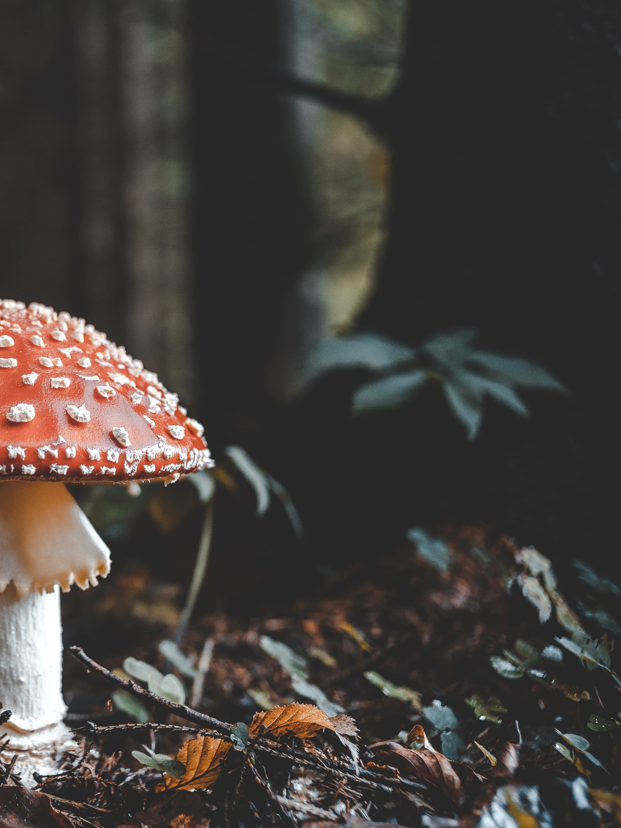

EDIBLE, OR NOT EDIBLE?
THAT’S THE QUESTION.
ABOUT US
Camilla Vittoria Di Martino
12123965
cv.martino@edu.aau.at
Alessandro Maccario
12116666
almaccario@edu.aau.at
Iman Ras
12125048
i.ras@edu.aau.at

Slide 2
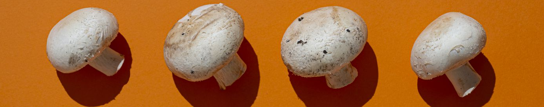
SELECTED PAPER
Title : «Mushroom data creation, curation, and simulation to support classification tasks.»
Authors:
Dennis Wagner
Dominik Heider
Georges Hattab
All from: Department of Mathematics and Computer Science, University of Marburg, 35043 Marburg, Germany.
Published on: www.nature.com/scientificreports
Complete citation: Wagner, D., Heider, D. & Hattab, G. Mushroom data creation, curation, and simulation to support classification tasks. Sci Rep 11, 8134 (2021).
https://doi.org/10.1038/s41598-021-87602-3

Slide 3
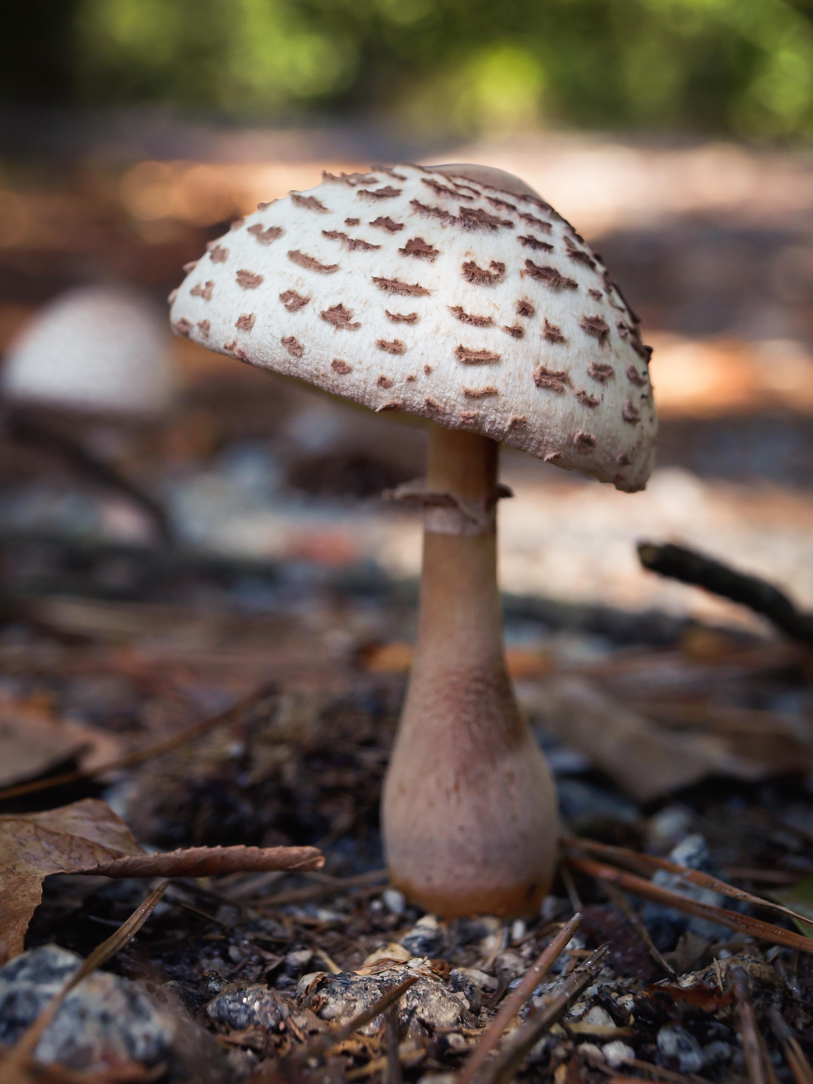
Our motivation and goals
OUR MOTIVATION:
The reason why we chose this paper is the peculiarity of mushrooms classification in the real word, which is a problem existing in nature that is easier to be solved with machine learning techniques.
OUR MAIN OBJECTIVES:
Crafting a workflow for the aim of binary classification and evaluation with the task to distinguish between poisonous and edible mushrooms.
To accomplish this goal we use more types of classifiers to explore different approaches to try achieve better results compare to the ones obtained in the paper.

Slide 4
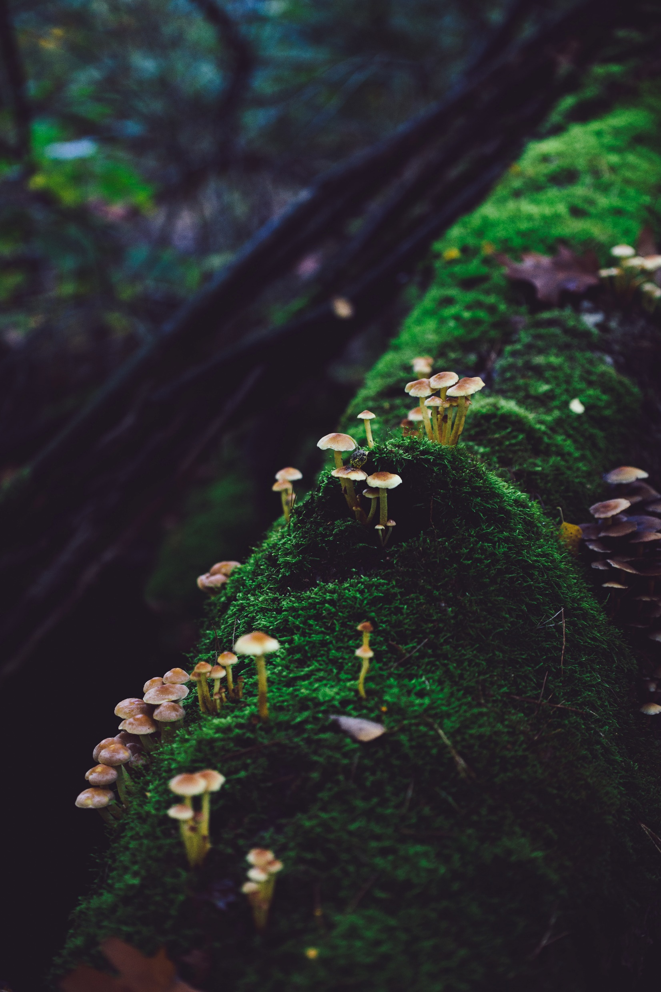
All datasets can be found at:
https://mushroom.mathematik.uni-marburg.de/
The dataset used consists of 23 variables and 8124 records. The attributes studied are the following (where n = nominal, m = metrical):
Cap-diameter (m)
Cap-shape (n)
Cap-surface (n)
Cap-color (n)
Stem-height (m)
Stem-width (m)
Stem-root (n)
Stem-surface (n)
9. Stem-color (n)
Does-bruise-bleed (n)
Gill-attachment (n)
Gill-spacing (n)
Gill-color (n)
Veil-type (n)
Veil-color (n)
Has-ring (n)
Ring-type (n)
Spore-print-color (n)
Habitat (n)
Season (n)
Family (n)
Name (n)
Class (binary)
DATASETS

Slide 5
System workflow
DATA ACQUISITION
ML TECHNIQUE
(RANDOM FOREST…)
EVALUATION METRICS
DISCUSSION OF THE RESULTS
PREPROCESSING
CONCLUSION

Slide 6
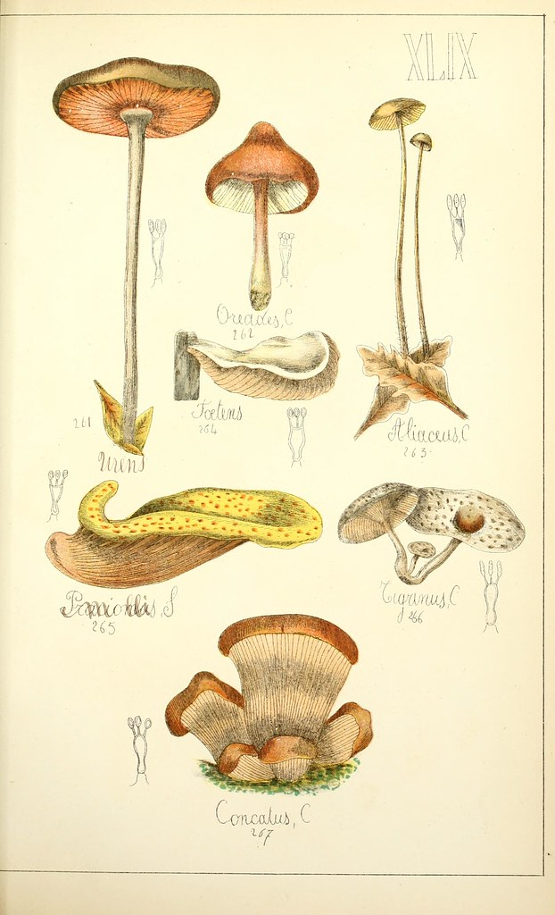


Expected output
The results we want to achieve is to better classify the nature of mushrooms and to improve the results obtained by exploiting further Machine Learning techniques.

Slide 7

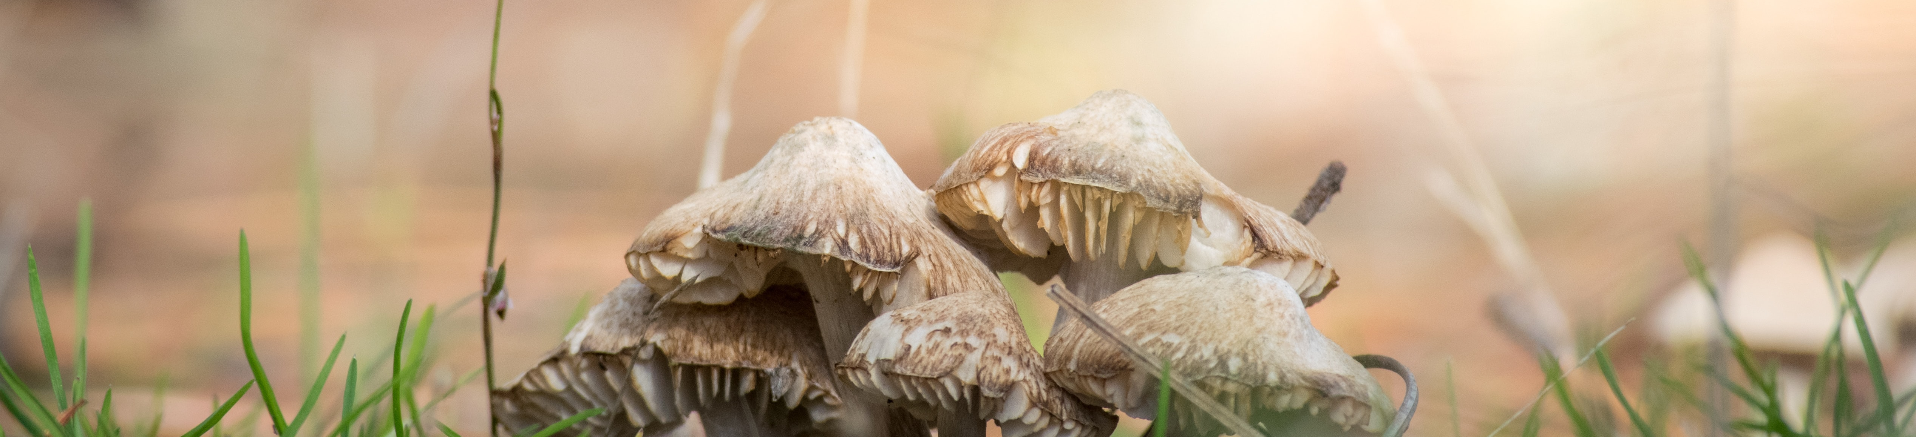
Work Distribution
The work will be distributed as follow:
Data Cleaning
Applying ML techniques
Evaluation
Iman Ras
Alessandro Maccario
Camilla Vittoria Di Martino
Reporting
All together

Slide 8


Slide 9
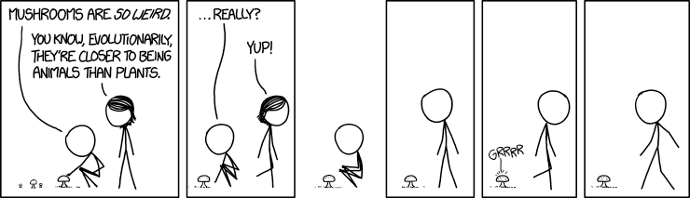
PREPARARE DISCORSO PER DIVIDERE PARTI TRA NOI TRE

